Slide 1

Shifting Left <<
<Presentation-2>
<< Infrastructure as code with Bicep and Azure
Part 1 – An introduction to using Bicep
Part 2 – Integrating Bicep with Azure DevOps
Notes:
Had wanted to show both the creation and integration but it wasn’t possible in the time I had available so talk 2 is going to implement it

Slide 2
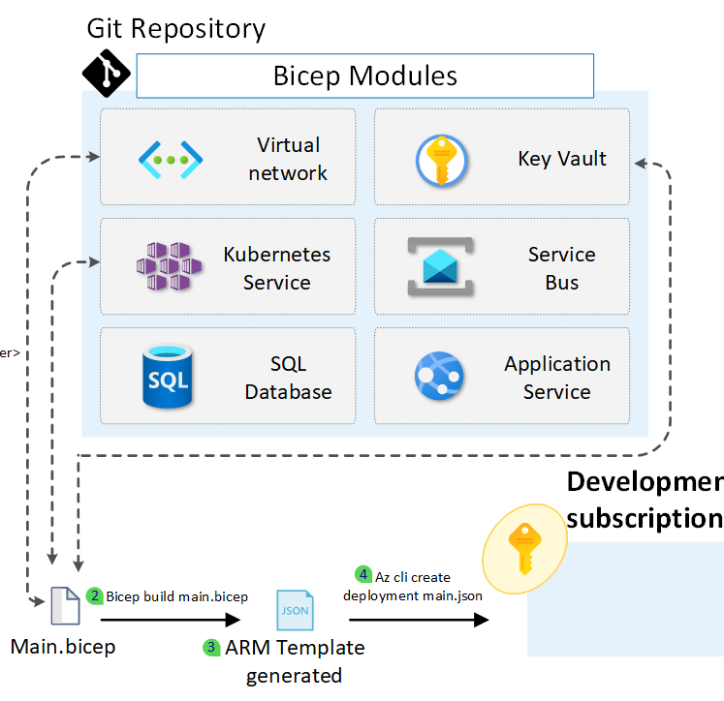
The resources to create
What resources we will create
Dev/Test/UAT/Production environments
Resource groups
B2C security
Static web application
Azure Isolated Function application
SQL Database
Storage Account
KeyVault
Application Insights for B2c/Website/APIs

Slide 3


Intro
Who am I?
Jon Baggaley (@WorthingCoder) / Twitter
linkedin.com/in/jonathan-baggaley/
Code & slides
github.com/zebslc/bicep-talk-2023

Slide 4

What am I going to talk about?
Quick overview of Bicep
The structure of pipelines
Yaml for beginners
Your first pipeline
Variables
Deploying your repos on the resources
Best practices
Notes:
Two parts to this talk – this is the overview with an outline of the bicep process and second talk will go into depth about exactly how you add to the pipeline

Slide 5

The code to deploy
Pipelines
Variables
The deployment of the git code
Static website
Azure function app API
SQL Database

Slide 6

Bonus info
Generating passwords for the pipeline with key vault

